Slide 1

Generating the Ollie Manoeuvre
Trajectory Optimization and its Application to Skateboarding
By Nicholas Anderson

Slide 2
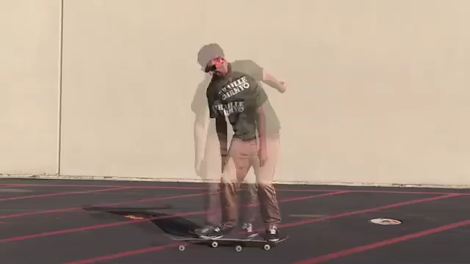
The Ollie
https://www.youtube.com/watch?v=OrOZxOTIv-g
Notes:
The ollie is the fundamental manoeuvre in skateboarding.
The pop, slide, apex, landing

Slide 3
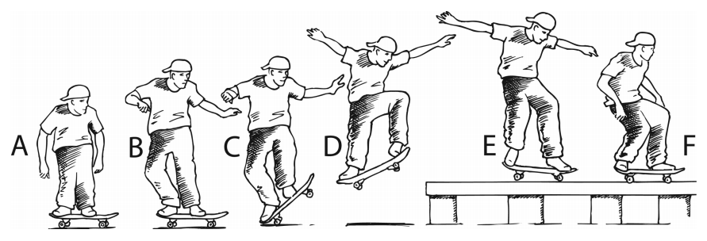
The Ollie
The Standing Ollie (SO)
The Rolling Ollie (RO)
The Ollie Down (OD)
The Ollie Up (OU)
Frederick et al., 2006

Slide 4
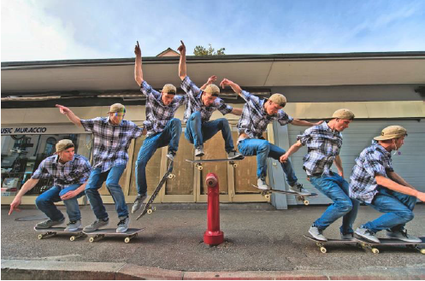
Trajectory Optimization
In its application to skateboarding…
Find input forces and torques
Perform the ollie
Satisfy constraints
Minimize cost/objective function
Notes:
It’s a special way of simulating motion where you don’t know how the motion is performed or the forces involved.
In its application to skateboarding, the trajectory optimization problems seeks to find a set of input forces and torques applied by the skateboarder on the skateboard in order to perform the ollie. The solution should satisfy a set of constraints such as … while minimizing the applied forces and torques.

Slide 5
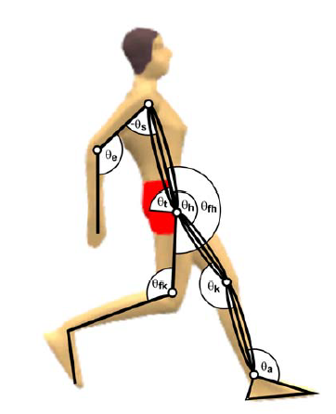
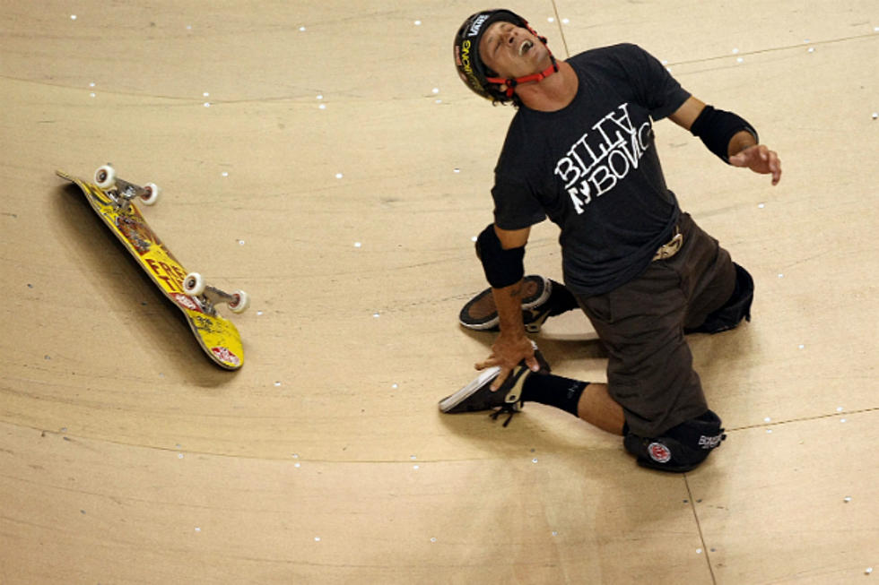
Trajectory Optimization in Motion Studies
Motion analysis
Injury identification and prevention
https://www.ncbi.nlm.nih.gov/pubmed/17509598
https://q1065.fm/skateboaders-huge-wipeout-prove-helmets-work-video/
Notes:
Motion studies – understand the key factors that influence motion. E.g. the effect of a high jumper’s arms on the jump height
Injury identification and prevention – understanding the forces involved on a skateboarder performing an ollie
Motion studies into skateboarding are sparse, even though skateboarding has been included in 2020 Tokyo Olympics.
Therefore, the aim of this project was to replicate the motion of the ollie manoeuvre and the ground reaction forces acting on the skateboard wheels.

Slide 6
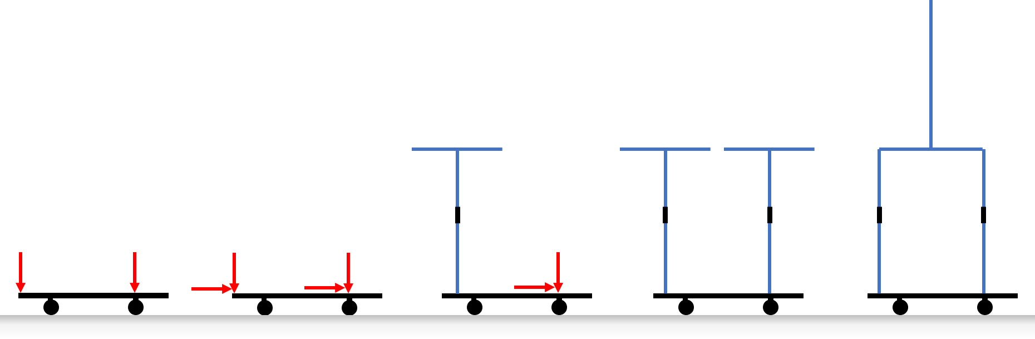
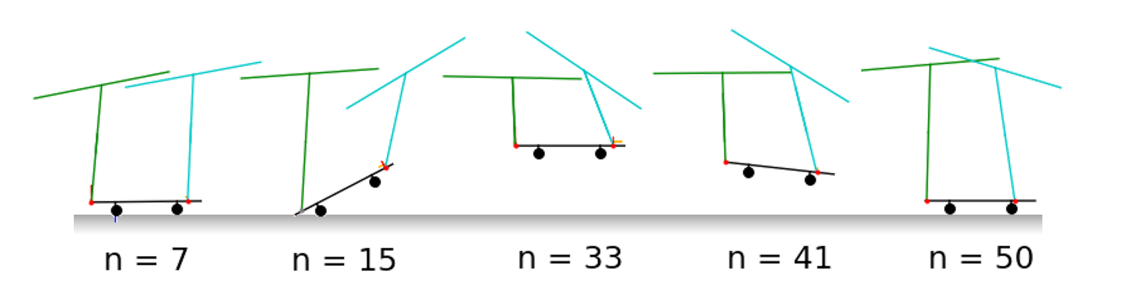


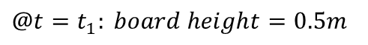
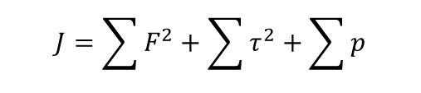
Methodology
Formulate Trajectory Optimization Problem
Model the System
$$…$$
$$J=\sum{F^{2}}+\sum{τ^{2}}+\sum{p}$$
$$@t=t_{1}: board height=0.5m$$
$$…$$
Implement & Test
Notes:
Iterative. Start with low complexity model of system, formulate traj opt problem, implement and test.
Increase complexity until model encapsulates the key dynamics of the real-bodies.

Slide 7
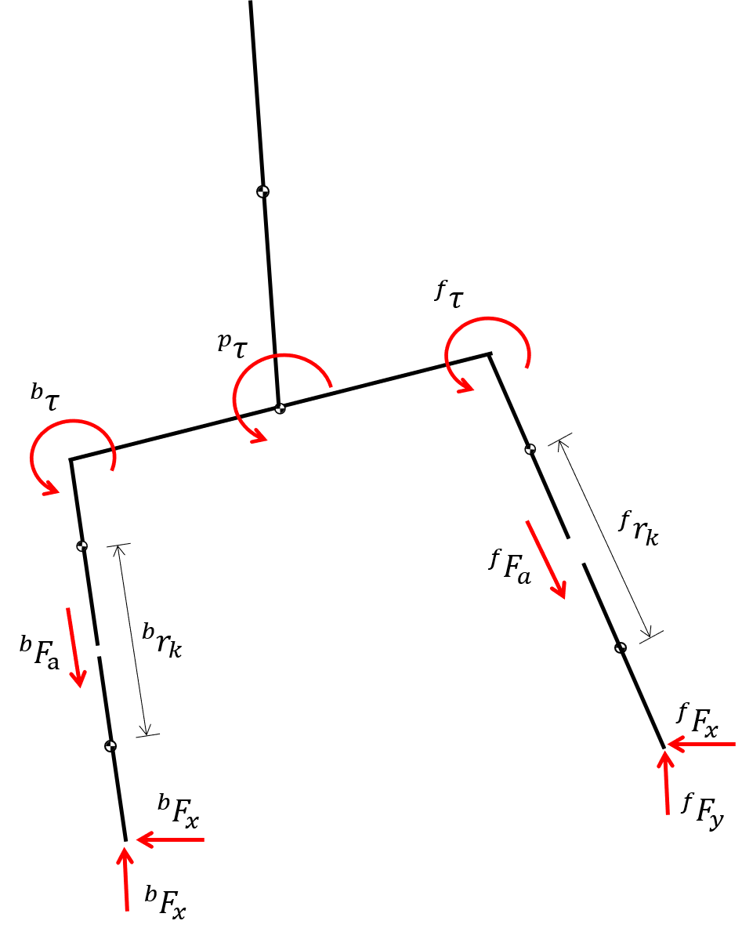
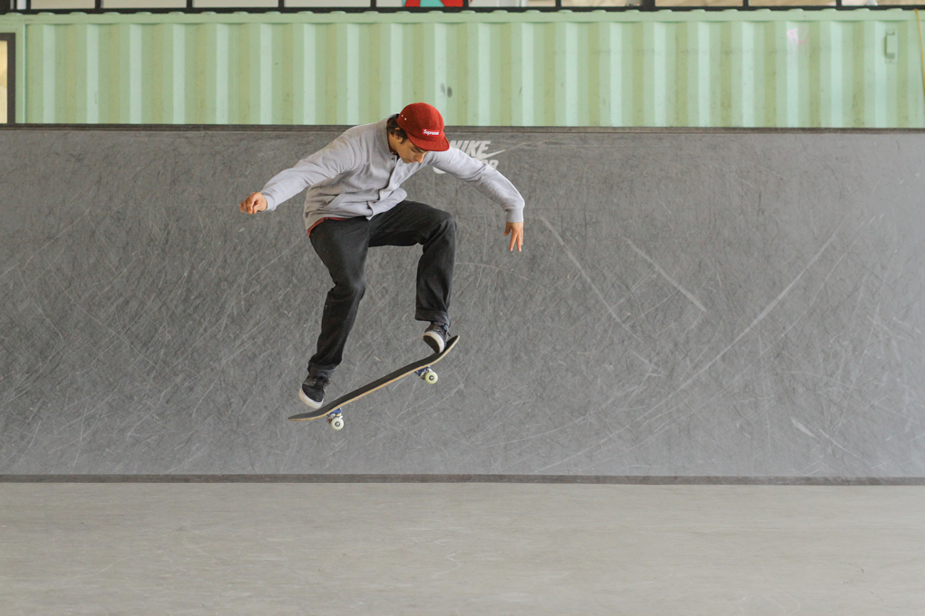
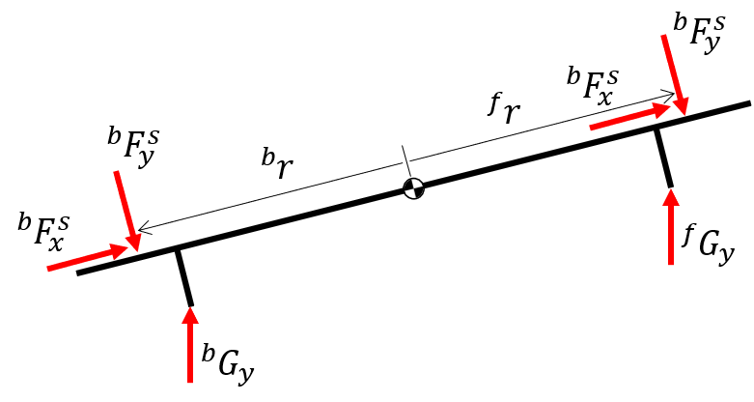
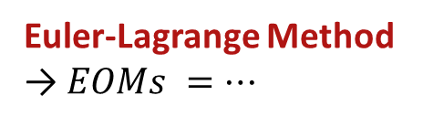
Modelling
Euler-Lagrange Method
→ $EOMs =…$
Skateboarder
Skateboard
https://sidewalkmag.com/skateboard-tricks/beginner-tricks/how-to-ollie-sidewalk-basics.html/2
Notes:
Skateboarder – open kinematic chain of rigid-links. Torso, pelvis and legs. Legs are modelled as prismatic joints.
Skateboard – A single rigid link with massless wheels and wheel bearings. Negligent friction at wheels.
Using the Euler-Lagrange method, the EOMs of the system were calculated.

Slide 8
Modelling
The foot-deck contact
Normal force – Inelastic
Friction force – Coulomb friction
The wheel-ground contact
Normal force – Inelastic
Negligible friction
The tail-ground contact
Elastic “pop”
The variable ground
Step-up or step-down
https://sidewalkmag.com/skateboard-tricks/beginner-tricks/how-to-ollie-sidewalk-basics.html/2
Notes:
Various multi-body contacts in the system which occur at dynamics positions.
Isolated and bouncing ball model used for development

Slide 9

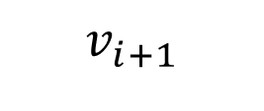
Formulating the Problem - Contacts
The Hybrid Dynamics Method
Scheduled elastic or inelastic collisions
Map states before and after a condition is met
$$v_{i+1}$$
$$v_{i}$$
Notes:
Two contact handling methods that were used:
Hybrid dynamic method which is for elastic and inelastic collisions.
Map the velocity of the skateboard tail before and after the collision using the coefficient of restitution
Drawback - scheduled

Slide 10
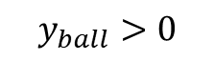
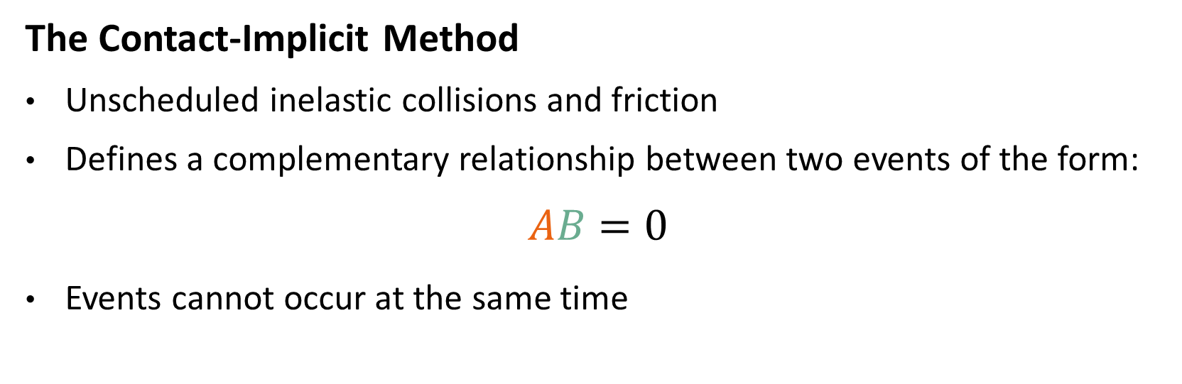
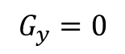
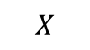
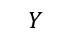
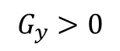
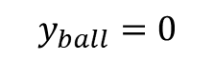
Formulating the Problem - Contacts
The Contact-Implicit Method
Unscheduled inelastic collisions and friction
Defines a complementary relationship between two events of the form:
$$AB=0$$
Events cannot occur at the same time
$$y_{ball}>0$$
$$Y$$
$$G_{y}=0$$
$$y_{ball}=0$$
$$X$$
$$G_{y}>0$$
Notes:
Contact-implicit for inelastic collisions and Coulomb friction. The pro for this method is unscheduled.
Complementary relationship between two events, forcing them to not occur at the same time.

Slide 11
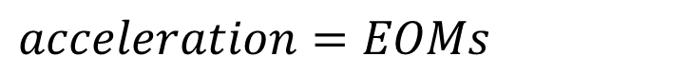
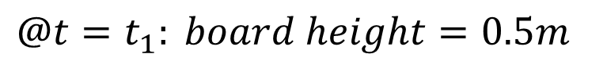


Formulating the Problem
CONSTRAINTS
THE OBJECTIVE FUNCTION
Some pseudo code examples…
Total Applied Force Squared
Penalty Variable
$$acceleration=EOMs$$
$$wheel height≥0$$
$$J=\sum{F^{2}}+\sum{τ^{2}}+\sum{p}$$
$$@t=t_{1}: board height=0.5m$$
Total Applied Torque Squared
Notes:
The constraints and objective function of the problem could now be specified. Examples of the constraints imposed on the system are …
The objective function was chosen to minimize the total force and torque applied by the skateboarder. A further penalty variable was added to increase the feasibility of the complementary relationships.

Slide 12
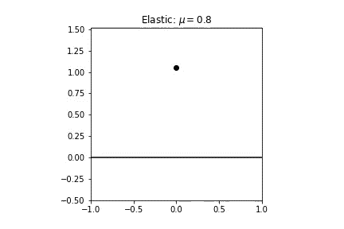
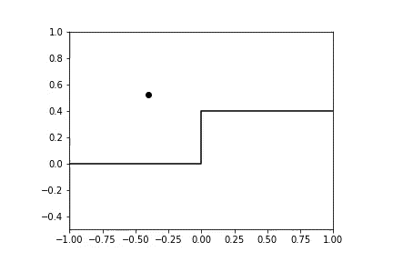
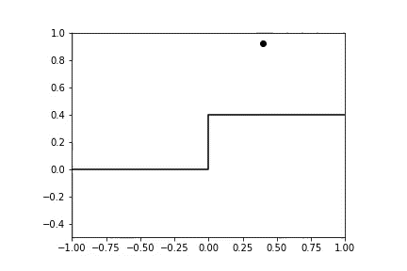
Development of Contacts – pt 1
Tail-Ground (elastic)
Wheel-Ground (inelastic)
Low-Step
High-Step
Notes:
Each of the contacts would now be isolated and tested.
Using the bouncing ball, the tail-ground contacts and wheel ground contacts were isolated and developed. The low-step and high-step tests were also incorporated into the tests.

Slide 13
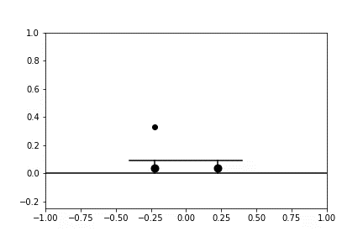
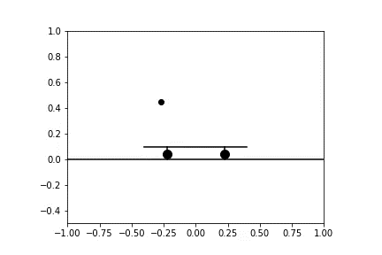
Development of Contacts – pt 2
Foot-Deck: Normal Force
Foot-Deck: Friction
Notes:
Then, the foot-deck contacts involving a normal reaction force and a friction force were isolated and developed.

Slide 14
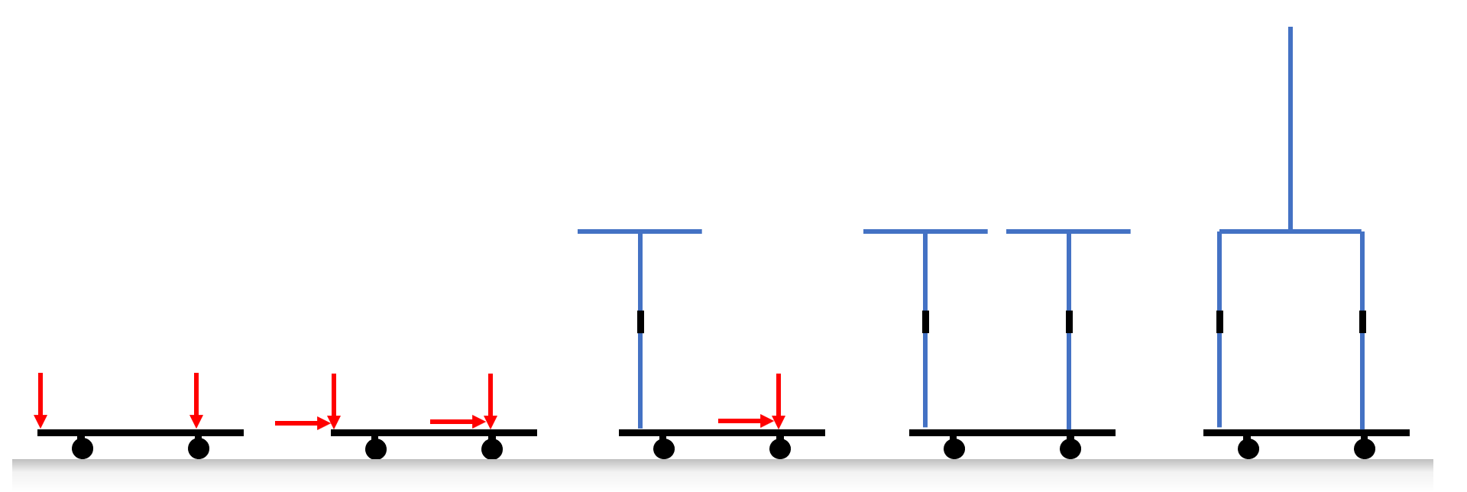
Model Evolution
Notes:
Now that the contacts within the system have been developed, the skateboard and skateboarder models could be developed from a low complexity model involving forces acting on the skateboard, to a higher complexity model with the skateboarder modelled as a biped. I call this diagram, the “model evolution”

Slide 15
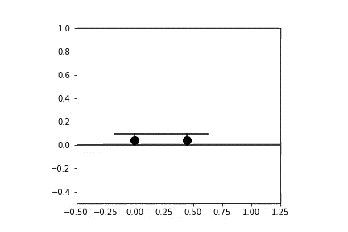
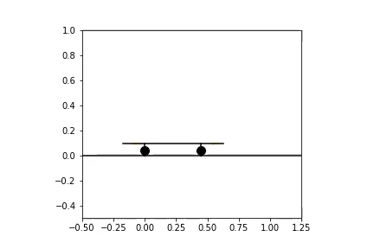
Development – Design 1
Fixed Applied Forces
Dynamic Applied Forces
Notes:
The first stages of development involved applied forces on the skateboard, initially fixed in position and then dynamic along the deck of the skateboard.

Slide 16
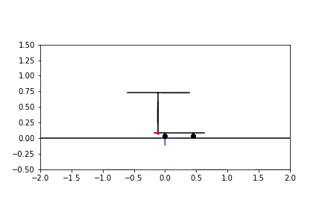
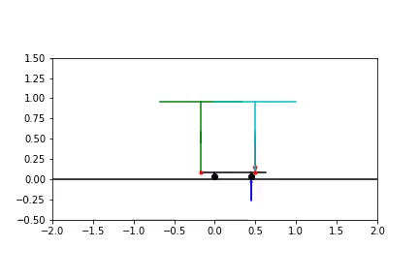
Development – Design 2
Monopod and Applied Force
Two Monopods
Notes:
The next design iteration included monopods on the skateboard which represented the skateboarder’s legs. At this stage, it was promising (and exciting) to see that, not only can the monopod lift its feet off the skateboard, but it is also able to slide it’s foot up the skateaboard.
Since these designs were successful, the final biped model could be formulated into the problem. The results were as follows:

Slide 17
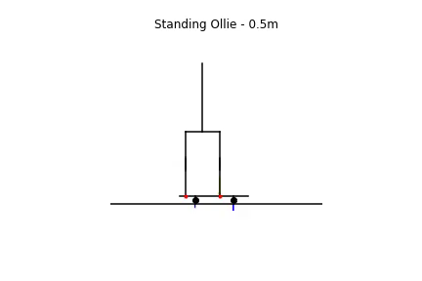
Notes:
A 0,5m standing ollie

Slide 18
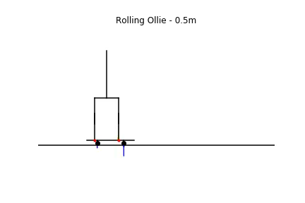
Notes:
0,5m Rolling ollie

Slide 19
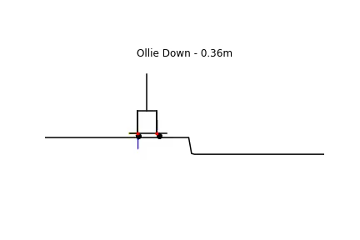
Notes:
0,36m ollie down. It should be noted that the characteristic “pop” was removed as it appeared that skateboarders often did not use this for small step-downs.
Under the time constraints of this project, the OU could not be successfully implemented.

Slide 20
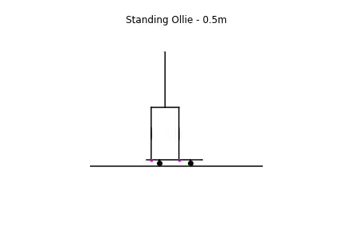

Comparison of SO Trajectory

Slide 21

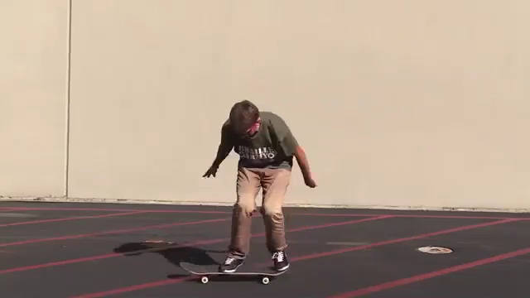
Comparison of SO Trajectory

Slide 22
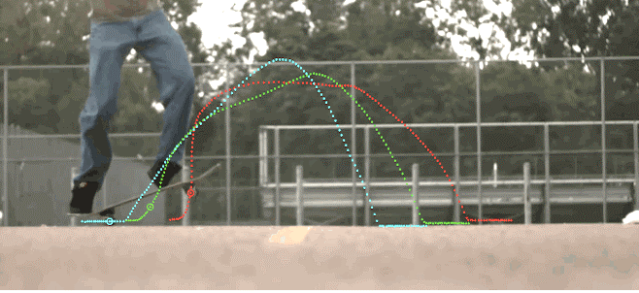
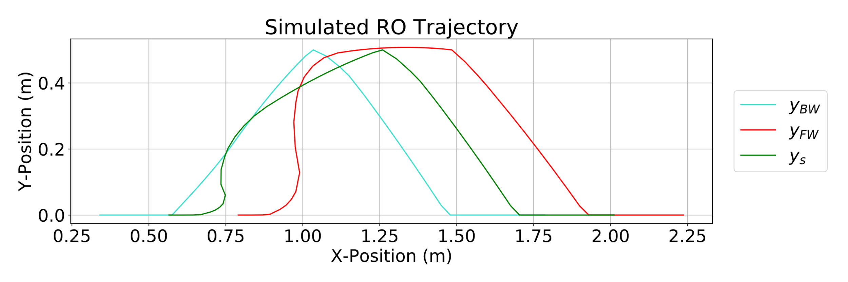
Comparison of RO Trajectory

Slide 23
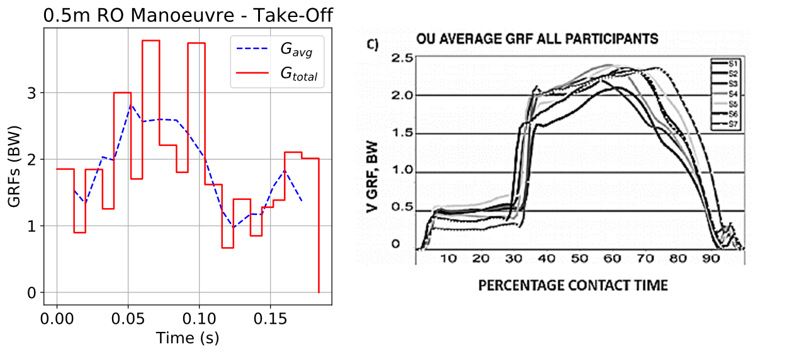
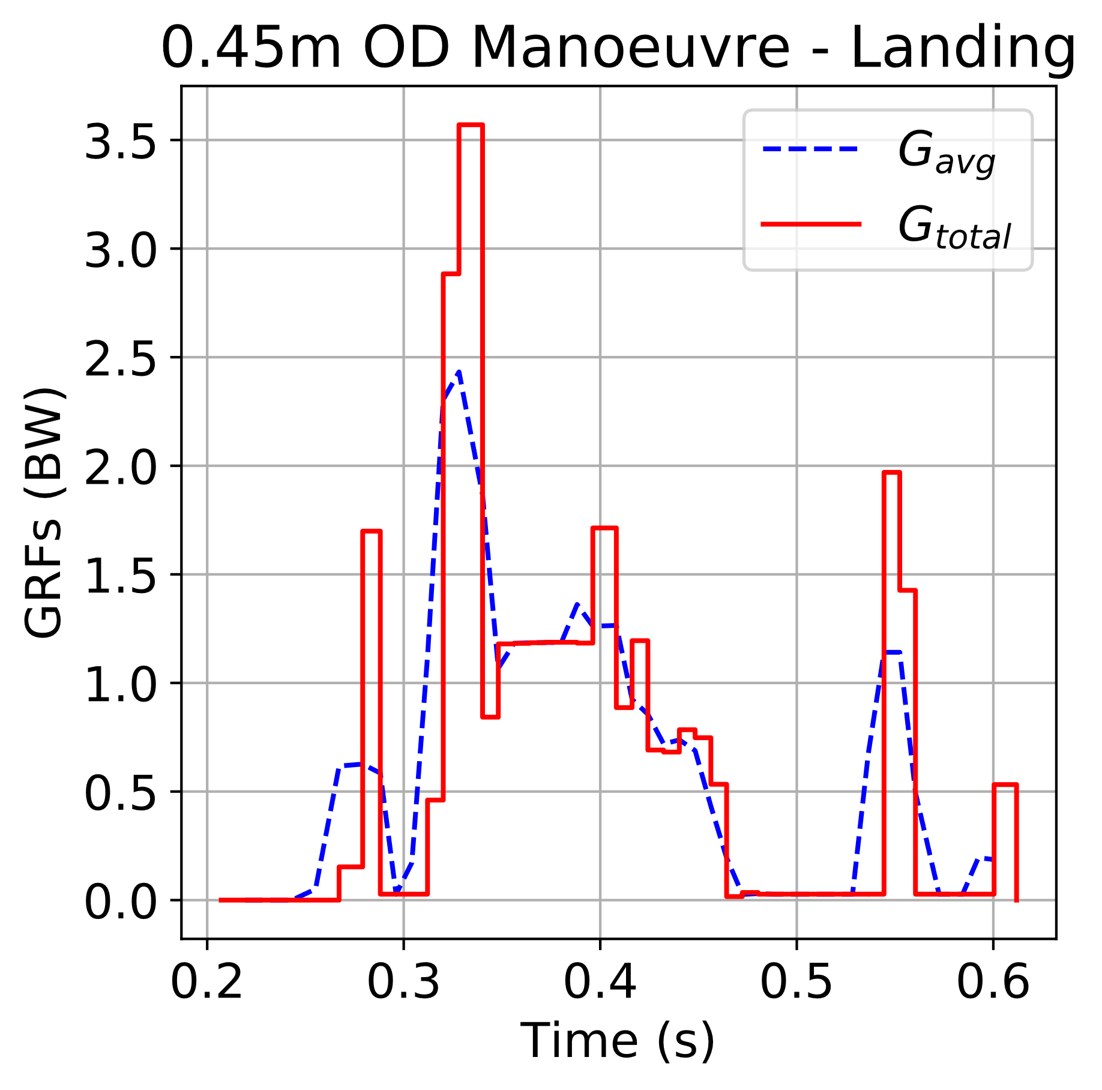
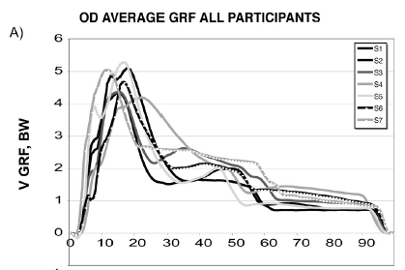
Ground Reaction Force Profiles
Rolling Ollie Take-Off
Ollie Down Landing

Slide 24
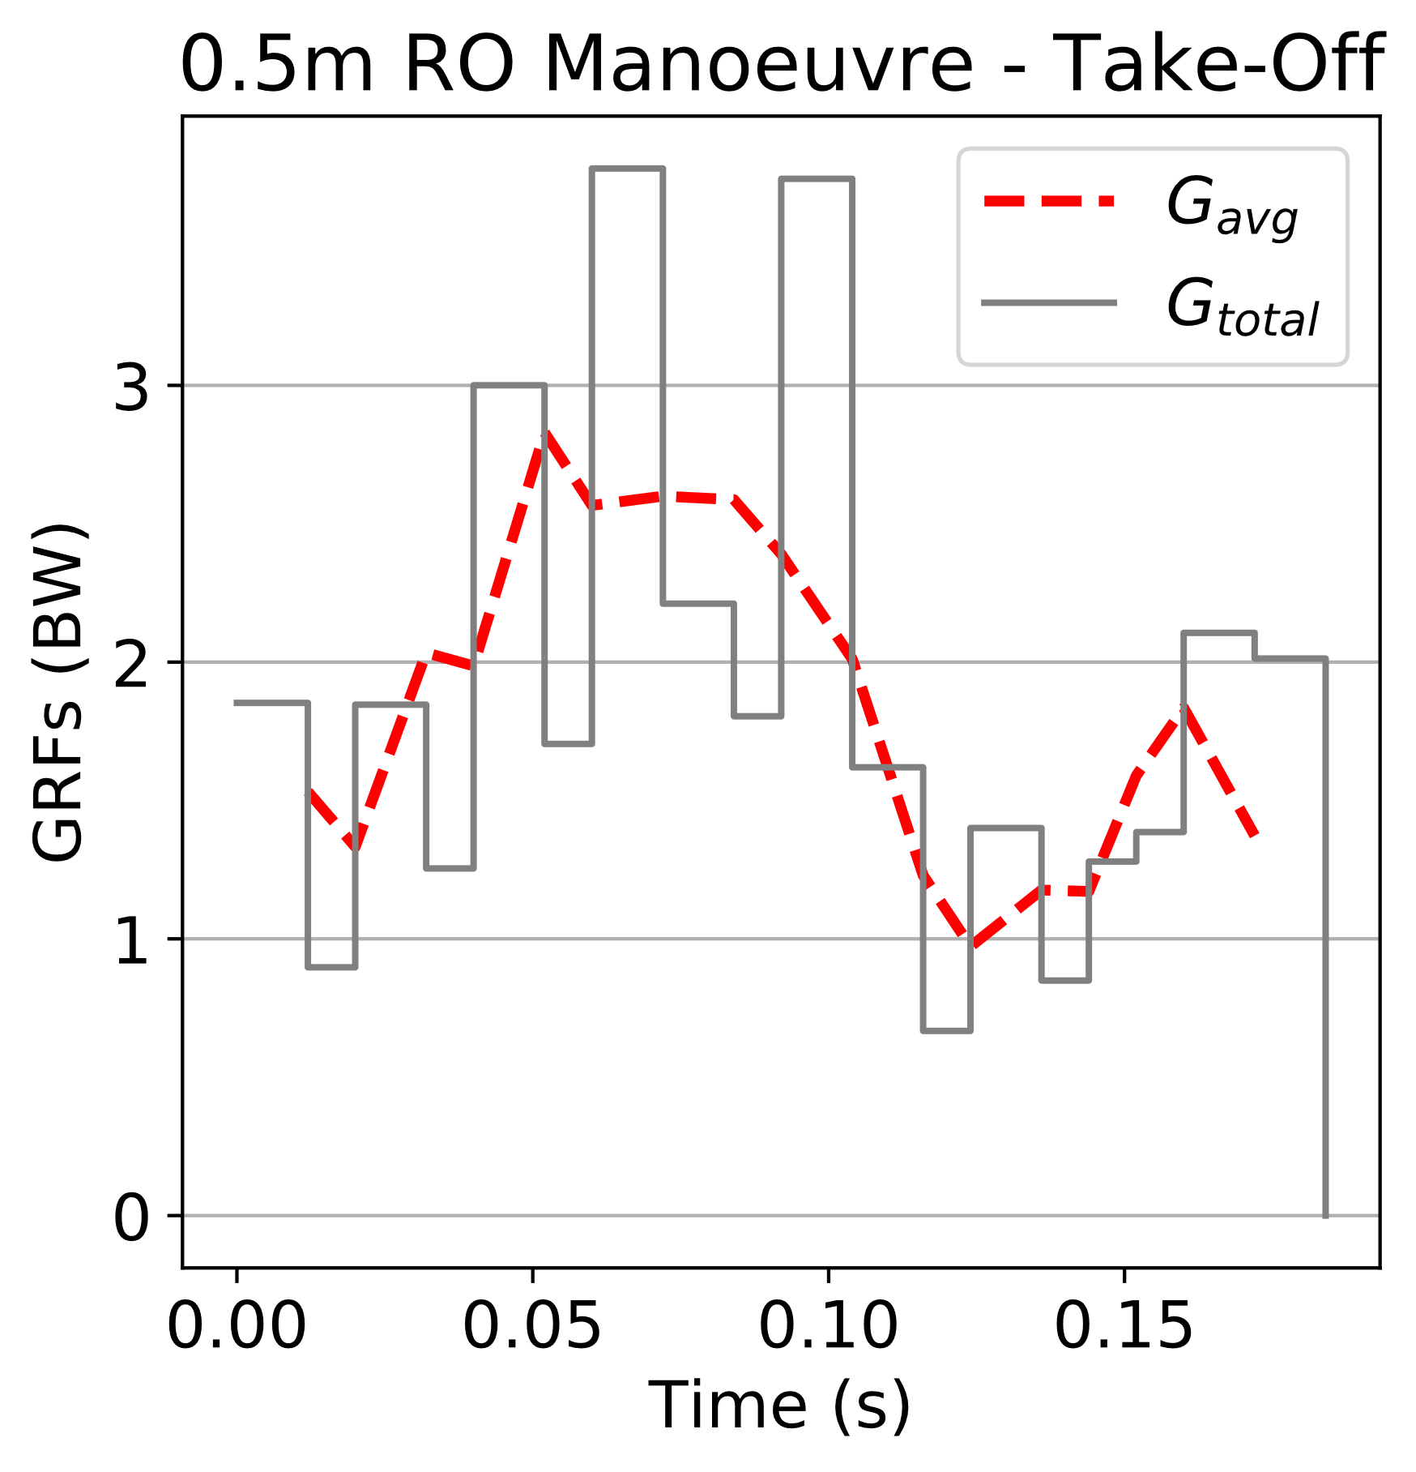
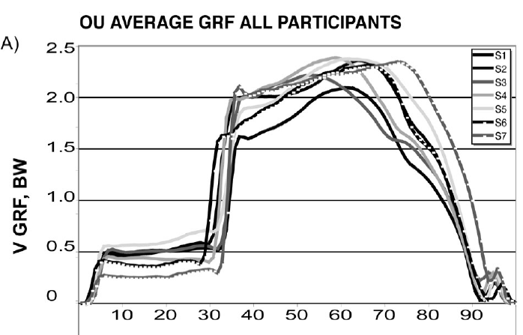
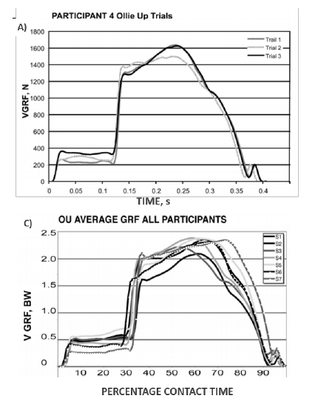
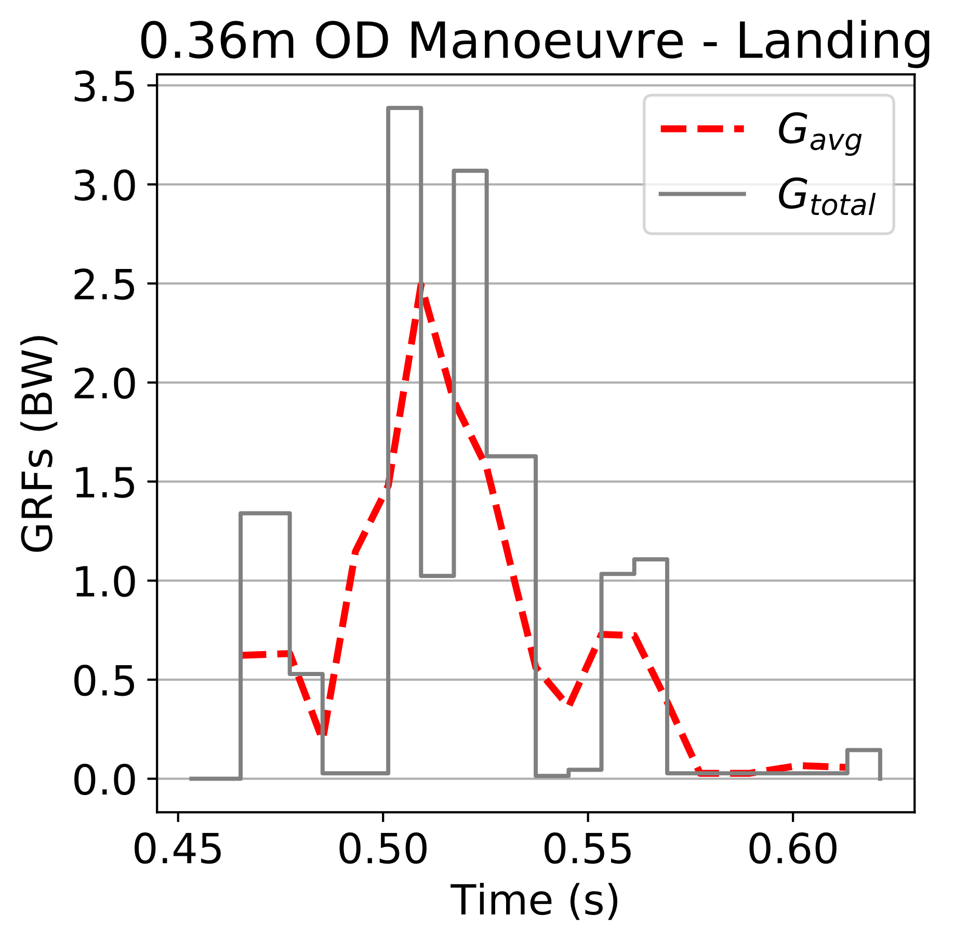
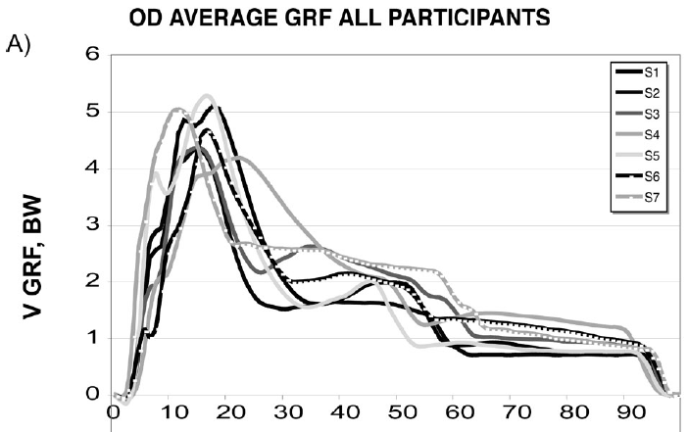
Ground Reaction Force Profiles
Rolling Ollie Take-Off
Ollie Down Landing

Slide 25
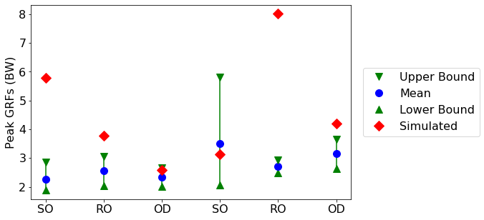
Peak Ground Reaction Forces
Take-Off
Landing

Slide 26
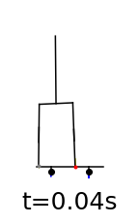











Conclusions
Unscheduled multi-body contact method was successfully implemented
Successfully replicated the motion of the ollie
General shape of GRF profiles bare basic resemblances
Magnitude of GRF profiles different
The model has the required complexity to replicate the ollie motion, but needs further development to improve accuracy of the simulated ground reaction forces.

Slide 27

Recommendations for Further Development

Slide 28


Not quite so impressive…

